Slide 1

Integrated Project–II | Progress Review –2
Skin Disease Detection System Using ML
Department of computer Science & Engineering
CHITKARA UNIVERSITY, HIMACHAL PRADESH
Submitted To: | Submitted By:
Ms. Tanu Minhas | 1.Rishav (2411981460)
 | 2.Ritika Kumari (2411981465)
 | 3.Sahil Rao (2411981479)
 | 4.Sakshi Yadav (2411981490)

Slide 2
Agenda
Project Overview
Requirement Gathering & Data Collection
Design Phase
Development Kickoff
SDG Goals Mapping
Multidisciplinary Approach
Novelty Factor
Challenges & Risks

Slide 3
Project Overview
Problem statement: Skin disease diagnosis is usually performed manually by dermatologists, which can be time-consuming and may lead to inaccurate or delayed results, especially in areas with limited medical experts. Doctors need a faster and more reliable system to assist in identifying skin diseases from images. This project proposes a Machine Learning-based Skin Disease Detection System that allows doctors to upload skin images and receive the top two predicted diseases with confidence scores, helping improve diagnostic efficiency and accuracy.
Objective: To develop a Machine Learning-based Skin Disease Detection System that helps doctors identify skin diseases by analyzing uploaded skin images. The system aims to provide accurate predictions with confidence scores, improve diagnostic efficiency, reduce manual effort, and support doctors in making faster preliminary diagnoses through a secure and user-friendly web application.

Slide 4
Project Overview
Scope:
The project includes a web-based skin disease detection system that allows doctors to securely log in, upload dermatoscopic skin images, and receive the top two predicted diseases with confidence scores using a CNN-based MobileNetV2 model. It covers image preprocessing, disease classification, user authentication, non-skin image validation, and result display through an interactive Flask-based interface.
The project does not include real-time camera diagnosis, treatment recommendations, hospital management integration, patient history management, or large-scale clinical deployment.

Slide 5
Project Overview
Stakeholders: Key stakeholders involved in the project include:
Doctors/Dermatologists – Use the system to assist in skin disease diagnosis
Healthcare Centers/Hospitals – Can use the system to improve diagnostic efficiency
Development Team – Responsible for designing, developing, and maintaining the system
Timeline:
Phase | Task | Time
Phase 1 | Problem Research & Dataset Collection | Week 1-2
Phase 2 | Data Preprocessing & Image Cleaning | Week 3
Phase 3 | Model Selection & Training | Week 4-5
Phase 4 | Model Testing & Accuracy Improvement | Week 6
Phase 5 | Interface / Application Development | Week 7
Phase 6 | Final Testing & Documentation | Week 8

Slide 6
Requirement Gathering & Data Collection
Sources of Data
• Existing Datasets: HAM10000 dermatoscopic skin image dataset obtained from Kaggle and research platforms
• Literature Review: Research papers and journals on AI and deep learning-based skin disease detection
• Medical References: Dermatology websites, medical articles, and online healthcare resources for disease-related information
Key Functional & Non-Functional Requirements:
Key Functional | Non-Functional Requirements
Upload dermatoscopic/skin images. | High prediction accuracy and reliability.
Image preprocessing (resize, normalization). | Fast response time for image processing.
Disease classification using machine learning / deep learning model. | Secure handling of uploaded images.
Display predicted skin disease with confidence level. | Scalable system for handling multiple users.
Simple and user-friendly interface. | Easy accessibility for non-technical users.

Slide 7
Requirement Gathering & Data Collection
Challenges in Data Collection:
• Limited availability of high-quality labeled dermatoscopic skin images • Class imbalance, where some disease categories contained fewer samples • Variations in image quality, lighting conditions, and skin tones • Requirement of preprocessing and dataset cleaning before training • Difficulty in obtaining medically verified data for accurate classification
Current Status of Project:
• Doctor login and registration system implemented • SQLite database integrated for user authentication • Skin image upload and preprocessing completed • CNN-based MobileNetV2 model trained and integrated with backend • System predicts top two skin diseases with confidence scores • Frontend and backend integration completed

Slide 8
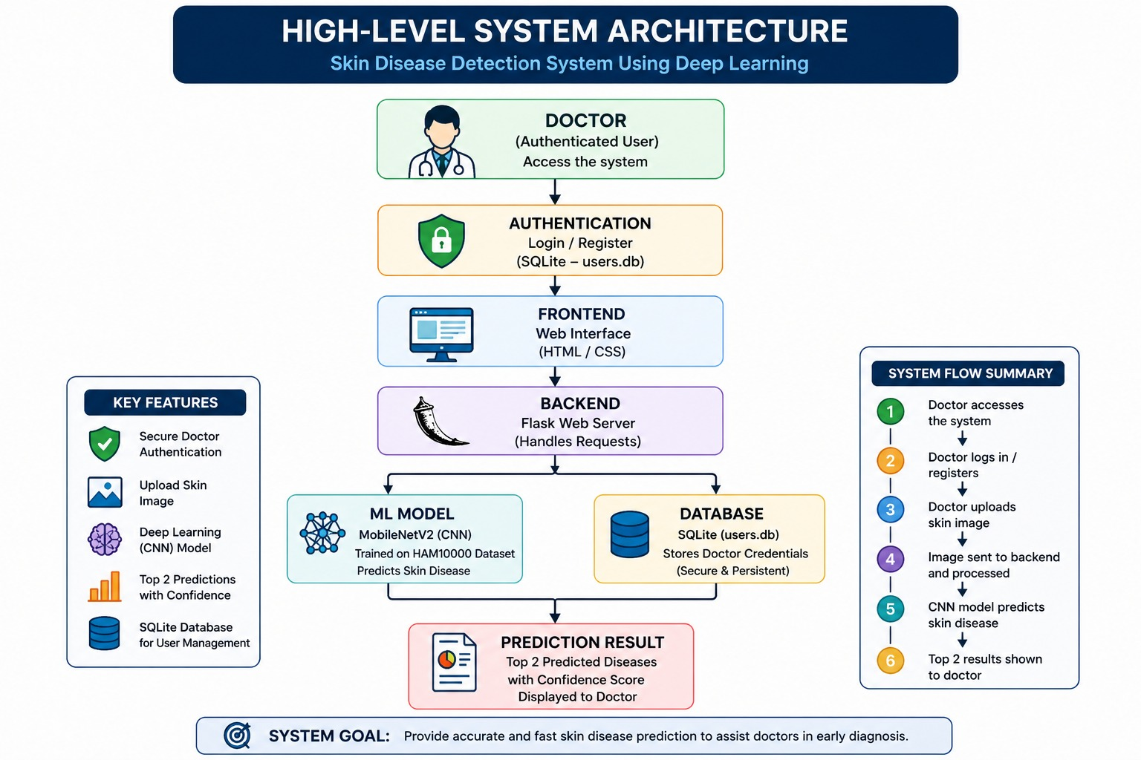
Design Phase
System Architecture:

Slide 9
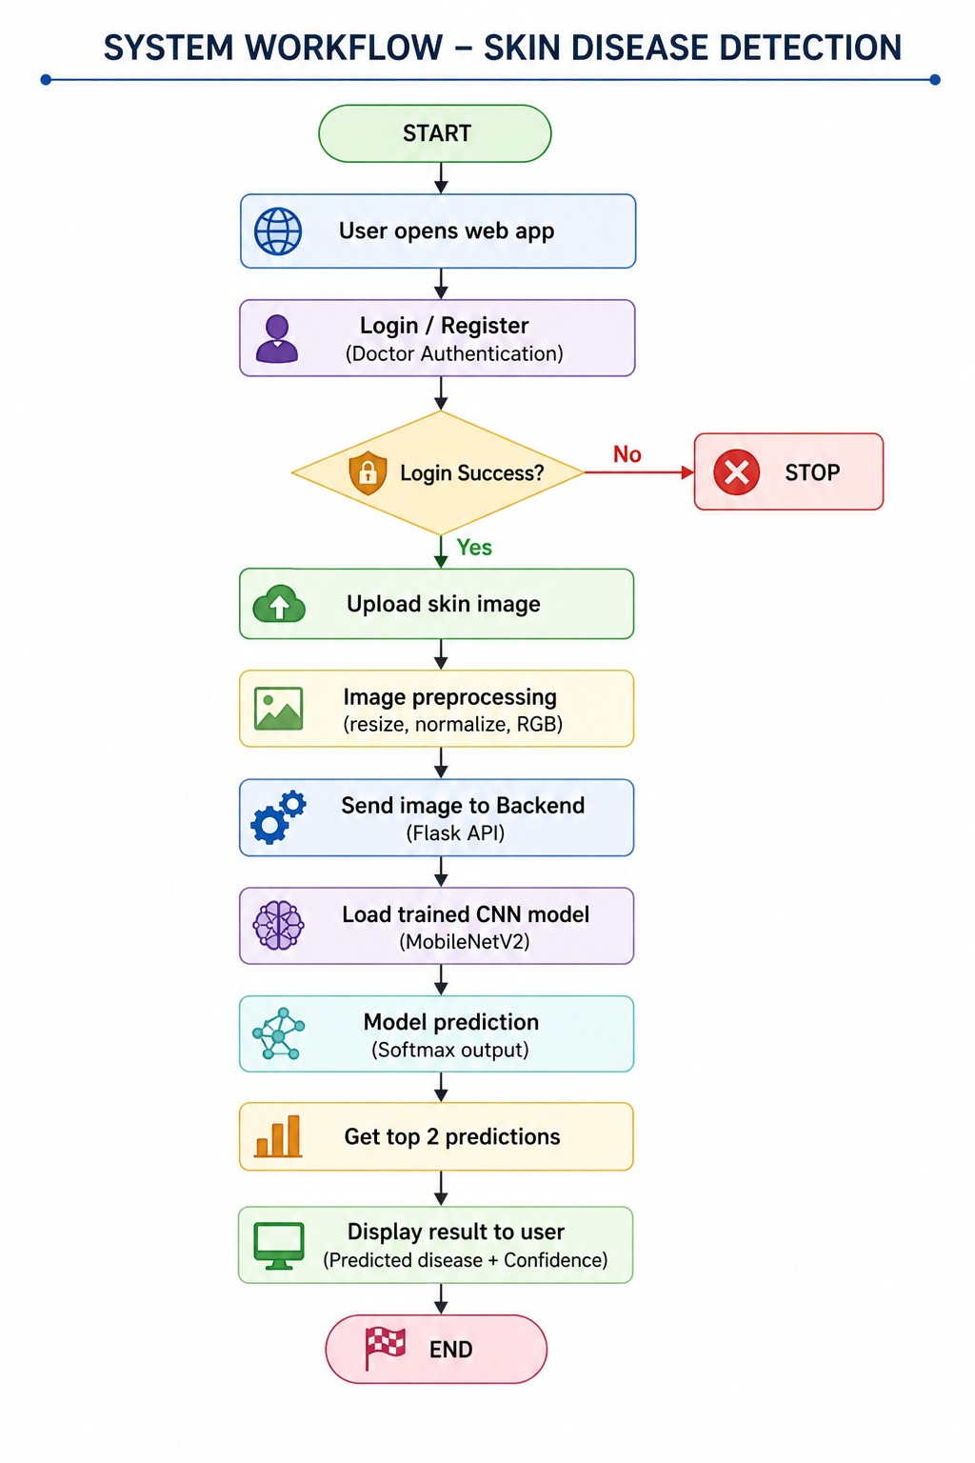
Design Phase
Flow chart:

Slide 10
Development Kickoff
Initial Codebase Setup
import tensorflow as tf
from tensorflow.keras.preprocessing.image import ImageDataGenerator
from tensorflow.keras.applications import MobileNetV2
from tensorflow.keras.layers import Dense, GlobalAveragePooling2D, Dropout
from tensorflow.keras.models import Model
from tensorflow.keras.callbacks import EarlyStopping, ReduceLROnPlateau, ModelCheckpoint

Slide 11
# HAM10000 CLASS → DISEASE NAME MAPPING# =========================================CLASS_NAMES = {
0: "Actinic Keratoses (akiec)",
1: "Basal Cell Carcinoma (bcc)",
2: "Benign Keratosis-like Lesions (bkl)",
3: "Dermatofibroma (df)",
4: "Melanocytic Nevi (nv)",
5: "Vascular Lesions (vasc)",
6: "Melanoma (mel)“
}

Slide 12
SDG Goals Mapping
SDG 3 – Good Health and Well-Being
The project helps in early detection of skin diseases using AI.
Supports better healthcare access and promotes early medical consultation.
SDG 9 – Industry, Innovation and Infrastructure
Uses Artificial Intelligence and Machine Learning technology to build an innovative healthcare solution.
SDG 10 – Reduced Inequalities
Provides low-cost and accessible diagnosis support for people in rural or resource-limited areas where dermatologists may not be available.

Slide 13
Multidisciplinary Approach
Fields Involved:
• Artificial Intelligence:
Used to train deep learning models for skin disease detection and classification.
• Data Science:
Applied in data collection, preprocessing, dataset balancing, and model evaluation.
• Computer Engineering:
Used for system development, backend integration, database management, and UI design.
• Medical Science:
Provides knowledge of skin diseases, symptoms, and diagnostic criteria.
• Healthcare Support:
Helps in understanding medical usability and practical application of the system.

Slide 14
Multidisciplinary Approach
Team Collaboration:
• Developers build the AI model, backend, and web application • Medical experts provide knowledge about skin diseases and diagnostic criteria • Researchers and data scientists manage datasets and improve model accuracy • Team members collaborate to ensure technical accuracy and medical usability
Interdisciplinary Innovation:
• Combines AI technology and healthcare for early skin disease detection • Uses deep learning-based image analysis for faster diagnosis support • Encourages collaboration between engineering, medical, and data science fields • Provides an innovative and accessible healthcare support solution

Slide 15
Novelty Factor
What Makes This Project Unique?
• Uses CNN-based Artificial Intelligence and image processing for automatic skin disease detection • Provides a fast and low-cost preliminary diagnosis support system • Offers a simple and user-friendly interface for image upload and instant prediction • Focuses on early detection and awareness of skin diseases • Integrates secure authentication, deep learning, and web technologies into a single healthcare solution
Comparison with Existing Solutions
.
Existing Solutions | Proposed Project
Requires dermatologist examination | AI-based automatic detection
Time-consuming diagnosis | Faster prediction
Expensive diagnostic procedures | Low-cost solution
Limited accessibility in rural areas | Can be used anywhere with a device

Slide 16
Challenges & Risks
Key Challenges Faced So Far
• Dataset imbalance affecting model prediction accuracy • Integration challenges between frontend, backend, and ML model • Handling preprocessing for varying image qualities and skin tones • Improving prediction speed and UI responsiveness • Ensuring secure login authentication and database management

Slide 17
Challenges & Risks
Identified Risks & Mitigation Strategies
Risk | Mitigation Strategy
Low prediction accuracy | Model tuning and preprocessing
Poor image quality | Image normalization and validation
Backend integration errors | Regular testing and debugging
Data security issues | Secure authentication and database handling
Slow system response | Performance optimization and efficient APIs

Slide 18
Next Steps
• Advanced Model Improvement:
• Improved model accuracy using balanced dataset and fine-tuning • Added non-skin image detection and validation testing
• Future Scope:
• Add prediction history and doctor dashboard • Improve system deployment and accessibility
• Research & Future Expansion:
• Train model on larger medical datasets • Explore real-time dermatoscopic image integration • Extend system for multi-disease medical diagnosis

Slide 19
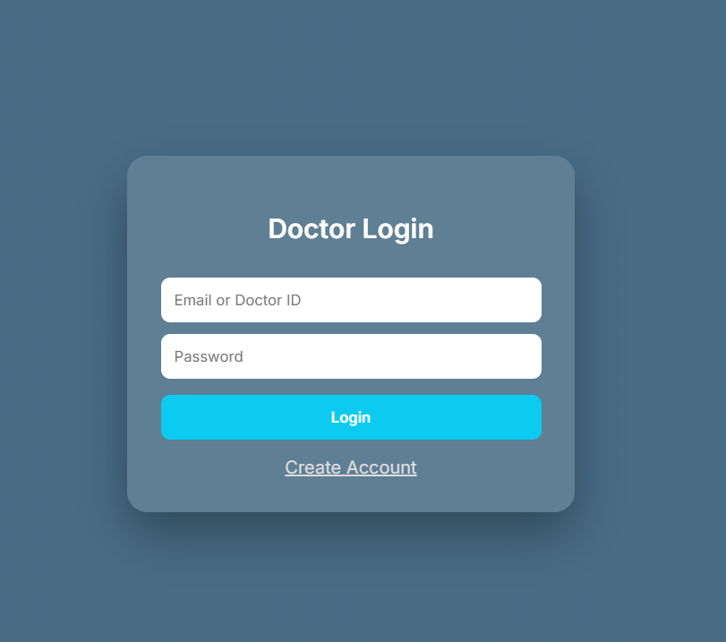
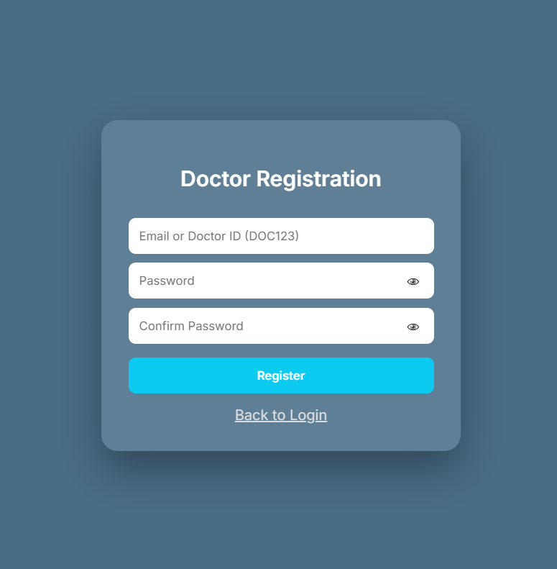
Snapshots of Project Implementation

Slide 20
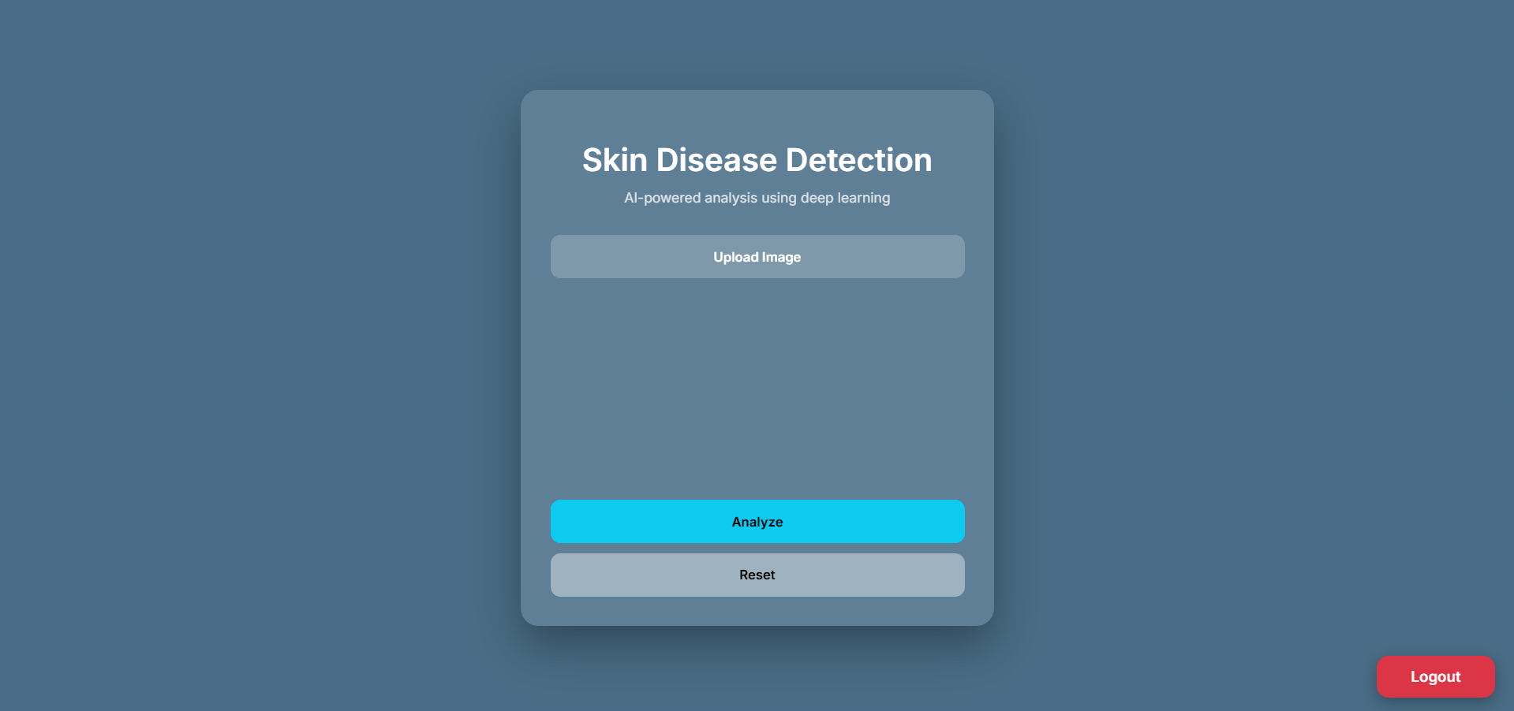
Snapshots of Project Implementation

Slide 21
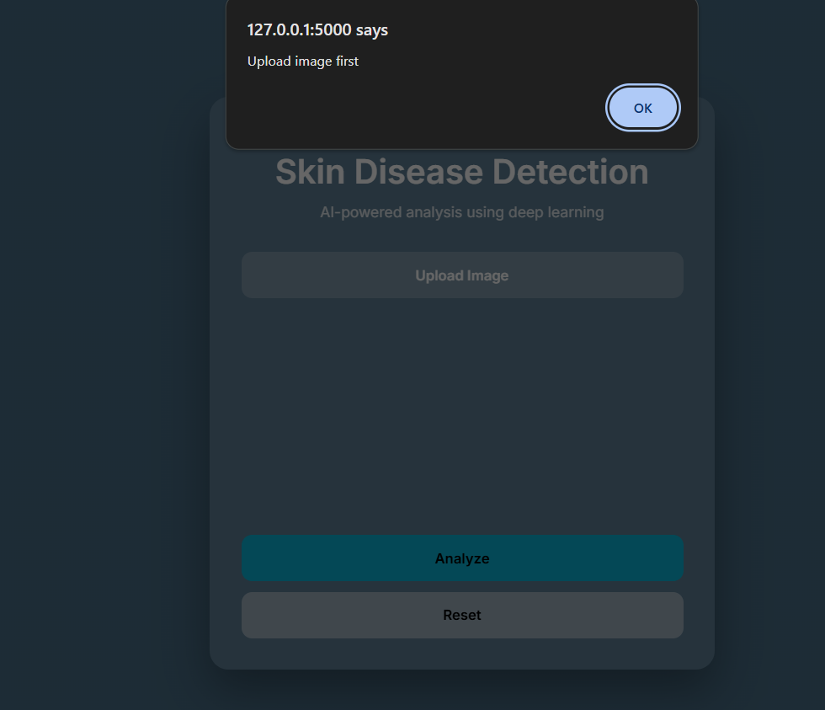
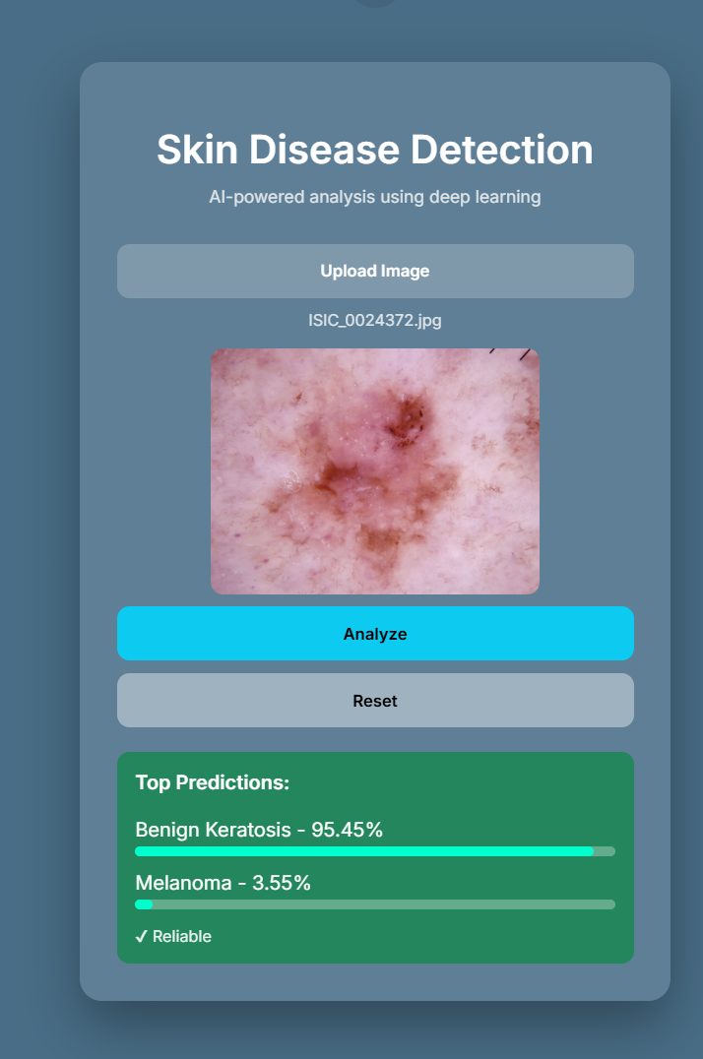

Slide 22
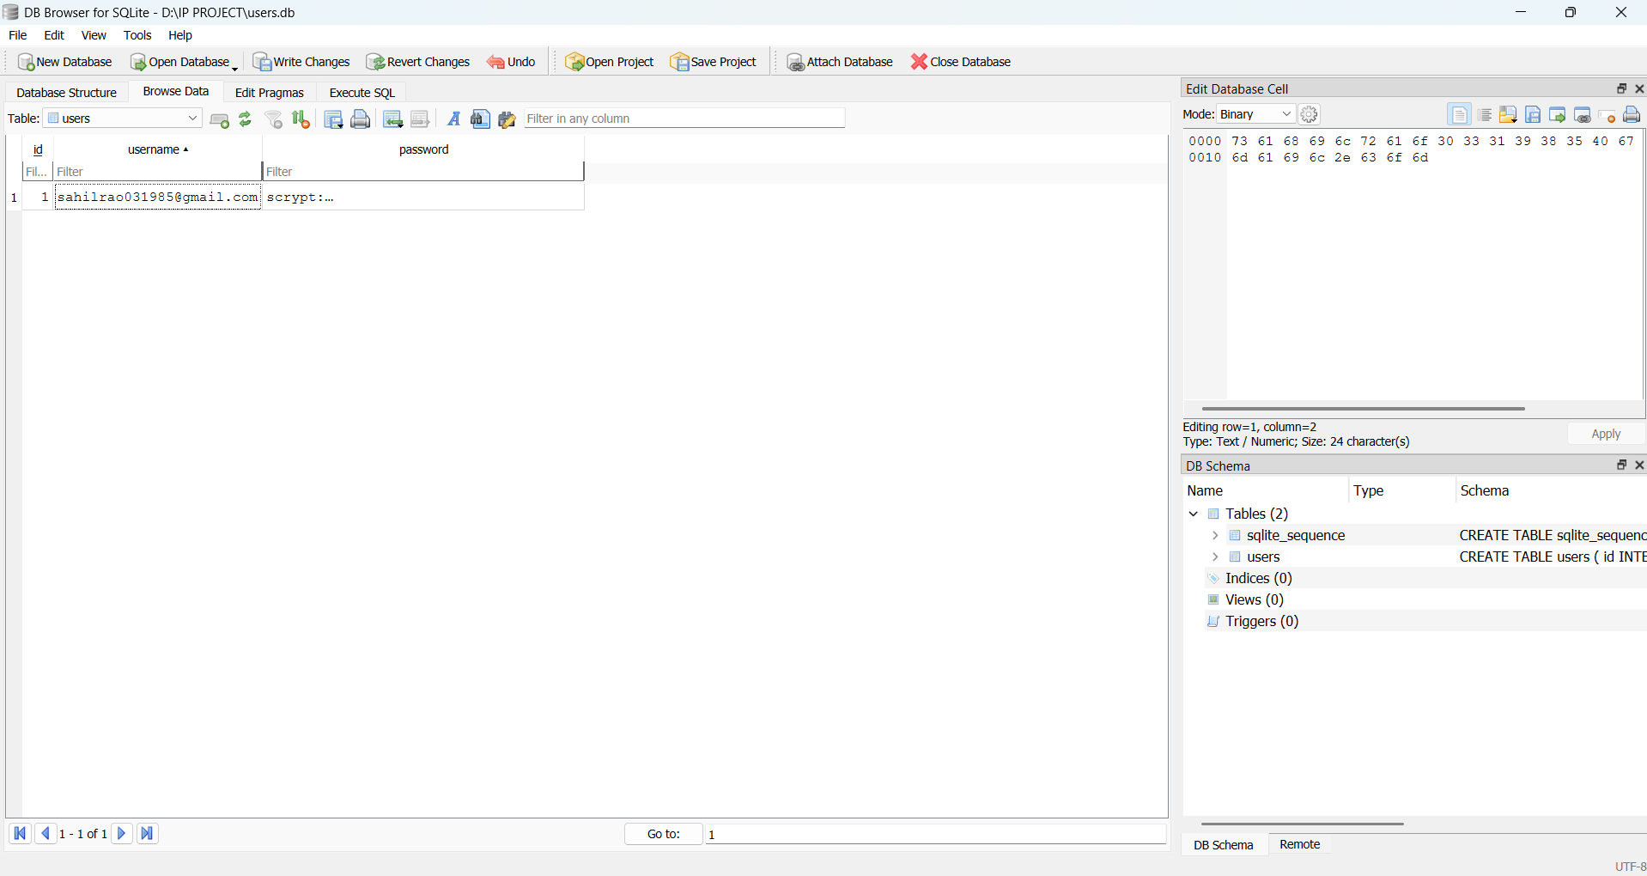

Slide 23
THANK YOU

